Slide 1


Arctic Ice Management
Presenters: Antonio Acuna, Kathryn Chamberlin
Johnathan Gamaunt, Professor Steven Desch, Dr. Stephen Romaniello, Professor Christopher Groppi
School of Earth and Space Exploration, ASU

Slide 2
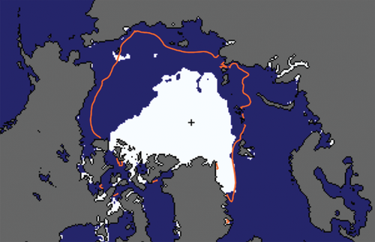
MOTIVATION
End-summer ice in Arctic is predicted to be gone by 2030s¹
  Causes positive feedback in climate system
Goal: increase Arctic sea ice production by pumping sea water onto ice sheets during the winter
Image from the National Snow and Ice Data Center
¹Desch, S. et al. (2017), Arctic ice management. Earth's Future, 5: 107-127. doi:10.1002/2016EF000410
Arizona NASA Space Grant Symposium 4/13/2019
Notes:
As the Earth’s climate has changed, Arctic sea ice extent has decreased drastically. It is likely
that the late-summer Arctic will be ice-free as soon as the 2030s
Positive feedback: the loss of sea ice creates a positive feedback, where sunlight that would otherwise be reflected by the ice is now absorbed by the ocean
It is unlikely that CO2 levels and the average temperature can be reduced fast enough to prevent the loss of ice
So Arctic ice management is proposing an initiative to enhance arctic sea ice production by pumping sea water onto the surface of the existing ice sheets during the colder winter months.
AIM is testing the feasibility of generating thicker layers of ice by testing for optimal parameters to encourage ice growth.

Slide 3
SCIENCE QUESTIONS
Science Objective | Measurement Objective | Science Product
Test how changing the flush frequency and flow rate affect the existing seed layer of ice. | Measure thickness of new ice formed | Ice thickness growth (cm)
 | Measure volume of water in runoff tank | Volume of ice growth for each experiment variable (m³)
 | Measure temperature of ice layers. | Temperature sensor readings (°C)
Determine the optimal flow rate and flush frequency to encourage growth of ice. | Monitor the delivery of water onto the surface and initial effects of water on the ice and how water freezes | Time lapse video of ice growth and effects of pouring seawater on existing sheet of ice
Do these conditions cause the water delivery pipe to freeze closed? | Monitor the water delivery pipe to see if pipe freezes closed | Time lapse video of delivery pipe
Notes:
How does the flow rate and volume of water affect the existing layer of ice?
What is the optimal flow rate and volume of water to encourage ice growth?
Do these conditions cause the water delivery pipe to freeze close?

Slide 4
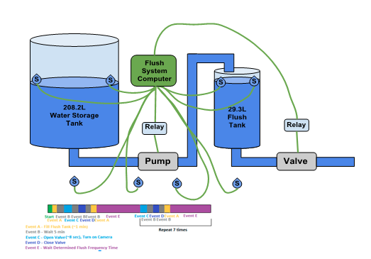
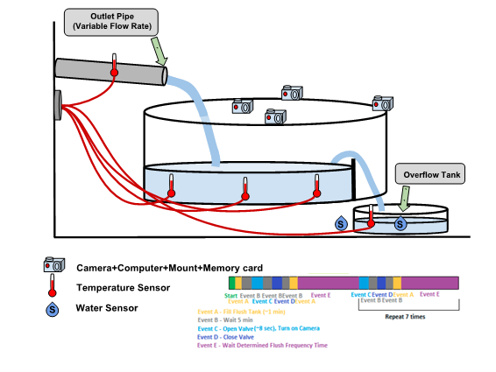
CONCEPT OF OPERATIONS
1
2
3

Slide 5
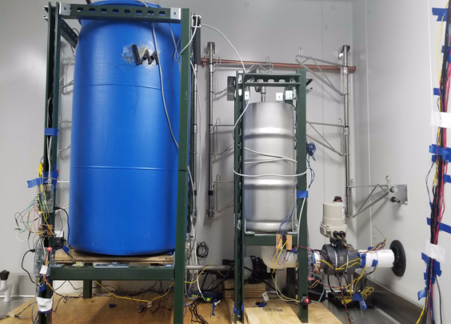
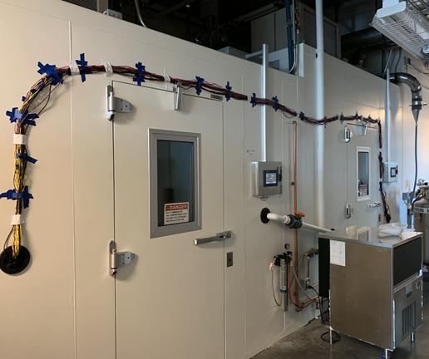
TEST APPARATUS
1
2
4
3
Refrigerator Setup
4ºC
55 gallon reservoir tank (1), 7 gallon flush tank (2), flush control valve (3)
3 separate computers
Refrigerator-Freezer Pass Through
Mass Flow Rate control valve (4)
Water sensor, temperature sensor, camera, and internet cabling
Notes:
-20C in freezer compared to Arctic is -40C in winter

Slide 6
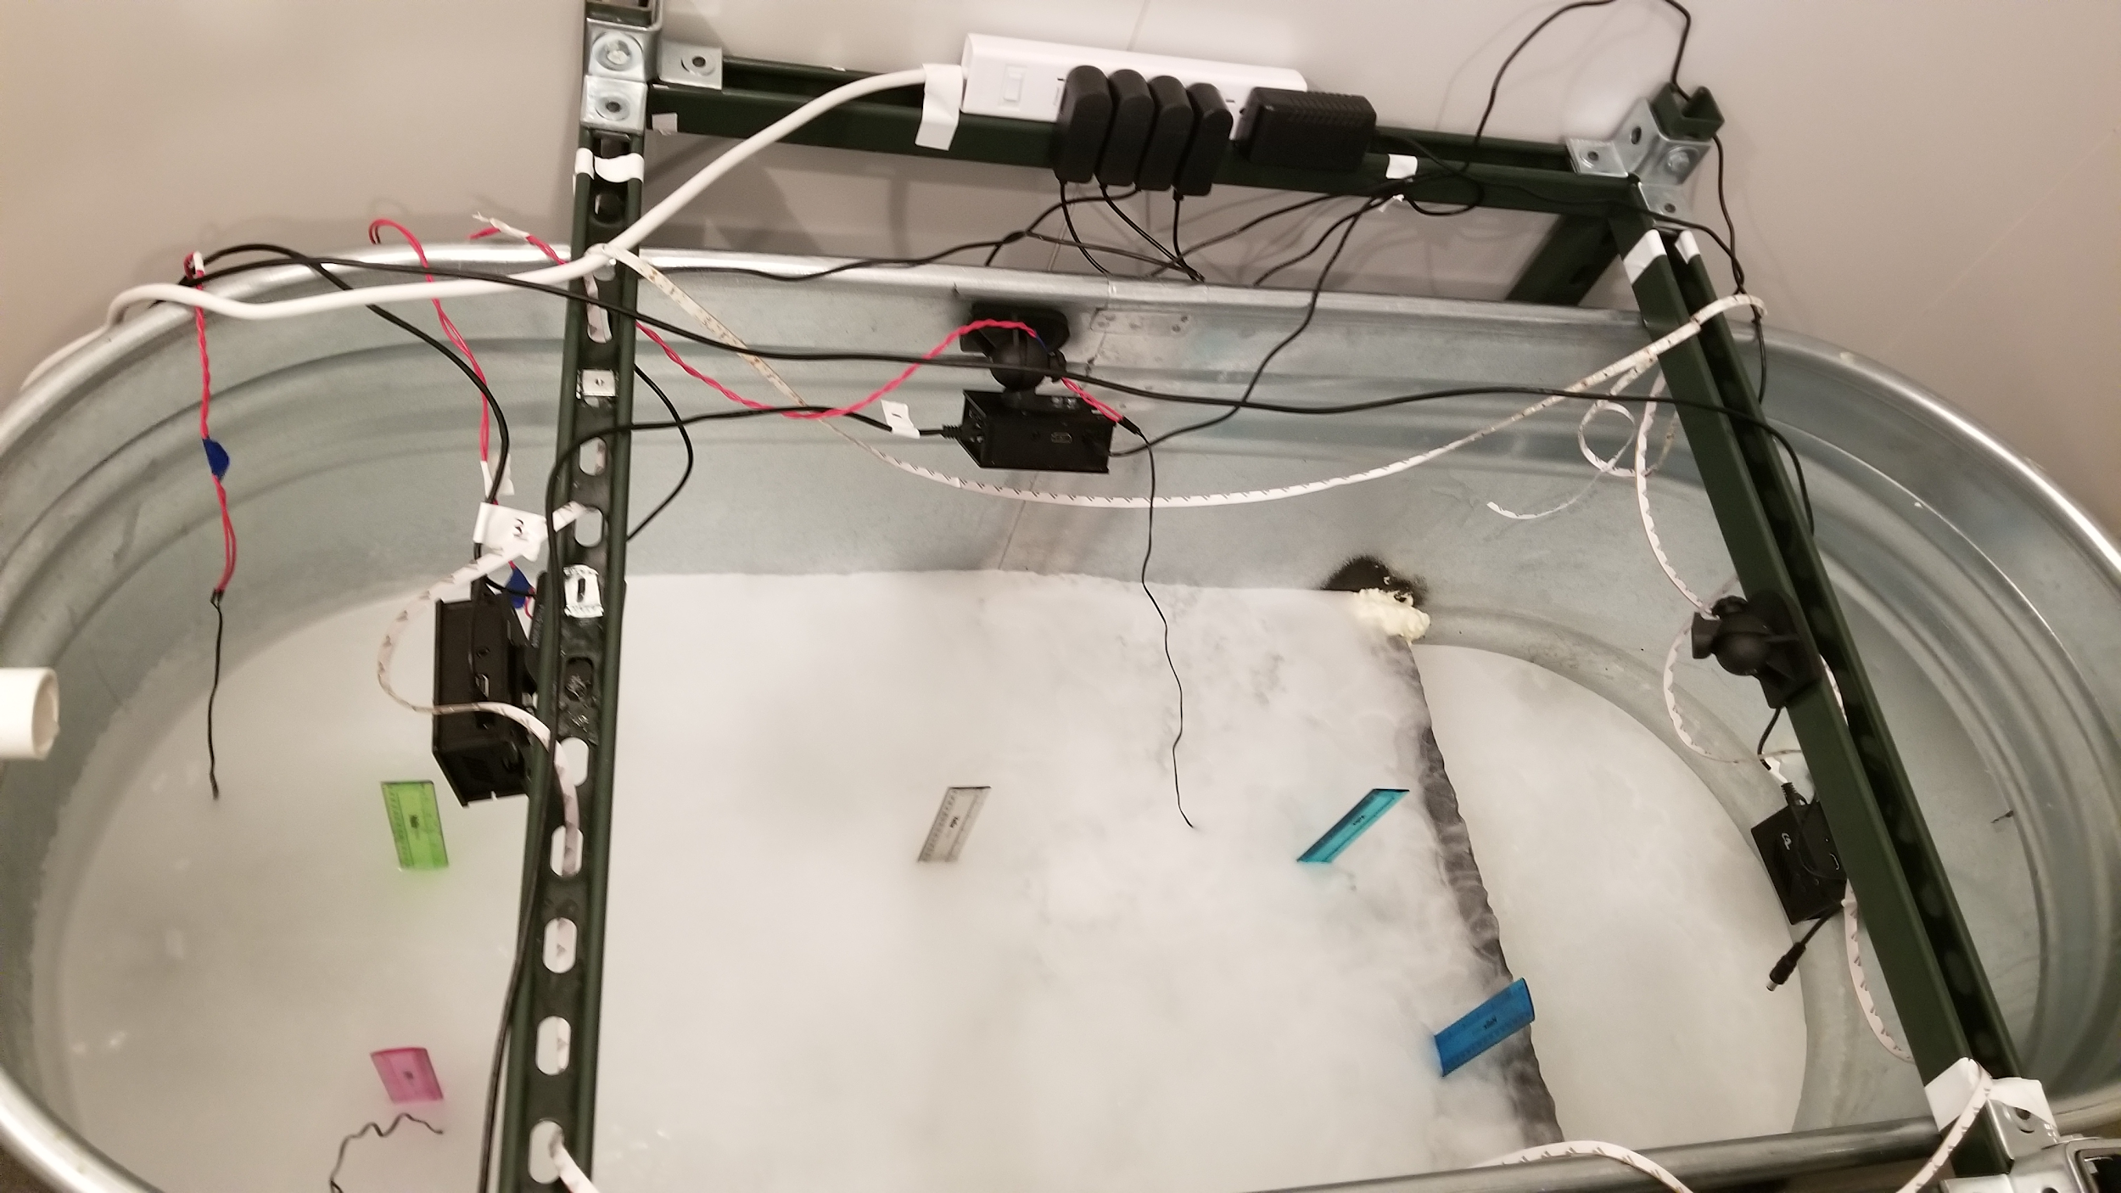
TEST APPARATUS
Freezer Setup
-20ºC
55 gallon trough
Three cameras
  View of ice growth from horizontal plane
  Water exiting the delivery pipe
  Top view of ice growth
Temperature Sensor | Depth Below Ice Surface (cm)
0 | 5
1 | 7.5
2 | 0.5
5 | 0.5
2
0
5
1
Notes:
First 5 minutes of every flush is video taped, then an image is taken every 5 minutes

Slide 7
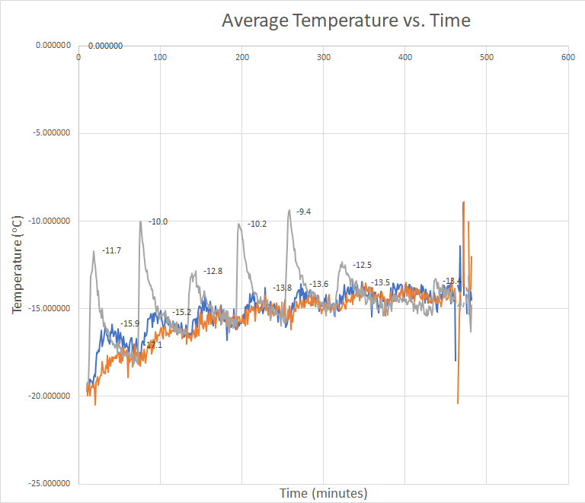
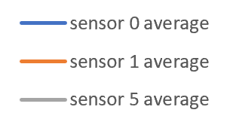
EXPERIMENTAL RESULTS
Experiment Variables:
  Flush Frequency: 1 hour
  Flush Water volume: 1 liter
  Mass flow rate: 0.02 kg/s
Notes:
-notice general warming trend of the block of ice
-each peak shows how the new flush increases the temperature of the ice
-grey line is sensor 5 which is 0.5cm below the surface
-orange line is sensor 1 7.5 cm below surface
-blue line is sensor 0 which is
-the third peak and 8th peak as seen by sensor 5 suggests not great water coverage so the area doesn’t warm up as much

Slide 8
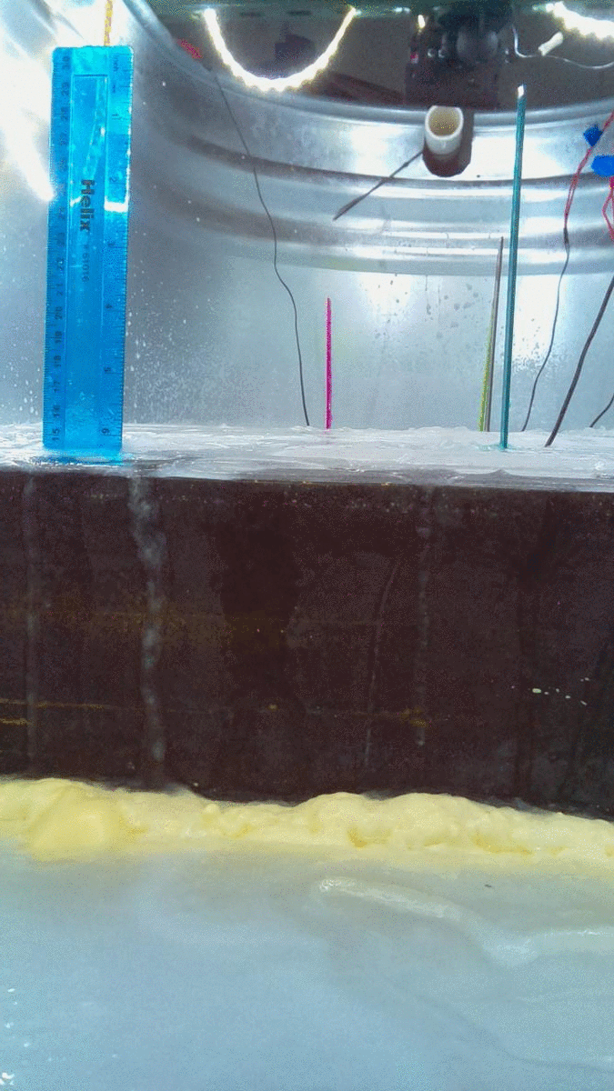
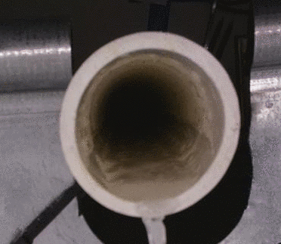
CHALLENGES OF EXPERIMENT
Conditions cause ice buildup in delivery pipe
Ice surface changes rough → smooth
  Rough:
    Advantages: prevents runoff
    Disadvantages: localizes water movement
  Smooth:
    Advantages: encourages water mobility/spread
    Disadvantages: increases runoff
Implementation in the Arctic
Notes:
Talk about trade off of surface texture and flow of water
Preventing/ Dealing with ice buildup up in the freezer section
Challenges faced while testing
Pipe freezing, surface roughness changing → run off

Slide 9
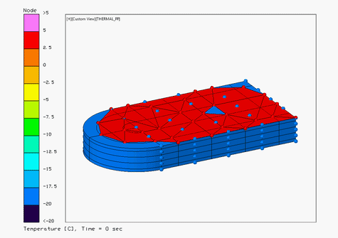
THERMAL MODEL
Computer model to test different scenarios before running lengthy lab experiment.
Heat transfers experienced in this experiment:
Convection between ambient air and water flushed on seed ice
  h_{c} = 3.02 W/m²K
Convection/Conduction between flushed water and seed ice
  h_{c} = 74.73 W/m²K
Radiation from flushed water and seed ice to freezer space

Slide 10
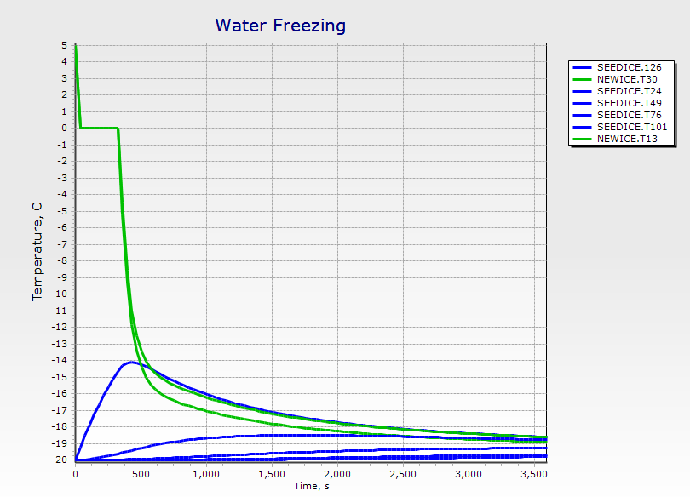
THERMAL MODEL
Time to freeze 1/16th in. layer of water in simulation = 324s
Time to freeze 1/16th in. layer of water in experiment = ~300s
An hour after flushing water onto seed-ice, the ice has not reached a steady state temperature of -20ºC
  Ideal to perform next flush after ice reaches steady state temperature

Slide 11
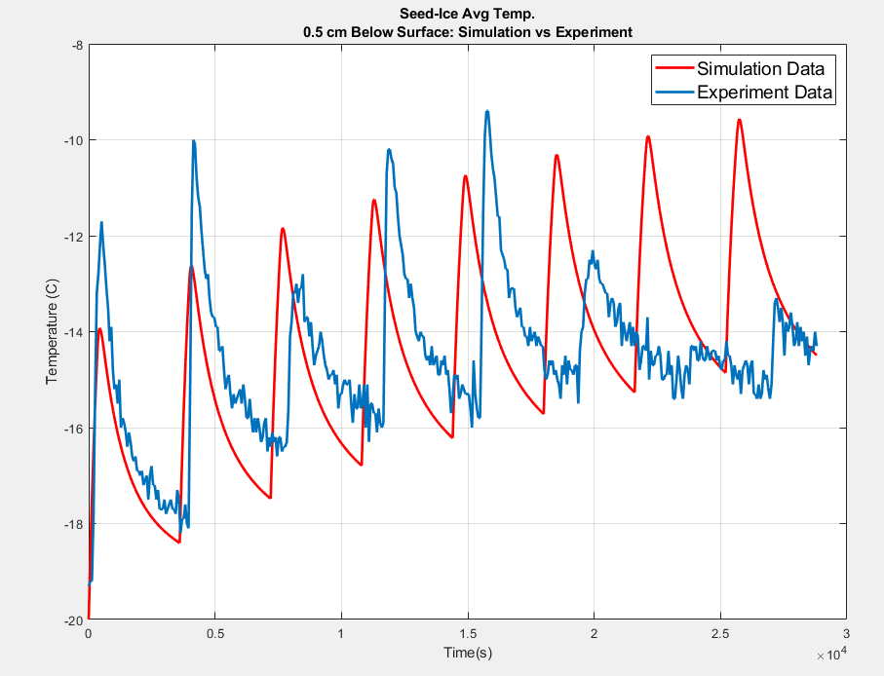
MODEL VS EXPERIMENTAL FLUSH RESULTS
Measured experimental values of 8 flushes vs Simulation results of 8 flushed at 0.5 cm below seed-ice
Higher temperatures reached in experiment than simulation
  avg difference in Temp of 2ºC
General temperature trend of seed-ice through flush cycle is consistent
Difference in temperature can be attributed to the surface roughness found in seed-ice, not incorporated in simulation
Notes:
How does this inform the Arctic?
Ice forms in delivery pipe
Flow time-estimate amount of time water is in pipe
Challenges faced while testing
Pipe freezing, surface roughness changing → run off
Measured Experimental values of 8 flushes vs Simulation results of 8 flushed at .05 cm below seed-ice
Higher temperatures reached in experiment than simulation
avg difference in Temp of 2ºC
At the end the data does NOT correlate
General temperature trend of Seed-Ice through flush cycle is consistent
Difference in temperature can be attributed to the surface roughness found in seed-ice, not incorporated in simulation
Experiment is having trouble maintaining consistent test run times toward end flushes, computer lag?

Slide 12
MOVING FORWARD
Determine conditions that don’t freeze water in delivery pipe
Determine amount of water it will take to break through a given thickness of ice
Develop more accurate way to measure the growth of ice per flush
How can we Implement as a field experiment in the Arctic?
Notes:
Impact on large scale experiment
How much water can we flush at once without burning through the ice
Brine wash?
How can we implement this on a field test?
Timeline, x years

